Slide 1

React-Native
Chase Moynihan and Miles McCloskey

Slide 2
What is React-Native?
Used to create mobile applications.
React Native is a javascript framework for building native mobile apps for android and iOS devices.
React applications are indistinguishable from applications created using objective-c or Java.
Using same UI building blocks as iOS and android, just putting them together using React and Javascript.
Replaces HTML and CSS with JSX

Slide 3
Advantages
JavaScript - Use existing JavaScript knowledge to your advantage
Code Sharing - Can share code on different platforms
Community - Large community for troubleshooting and problem solving
Hot Reloading - Don’t need to recompile code
Can use API’s for device interaction (Fetch, Redux, React Navigation)
CameraRoll
Geolocation
Vibration
Share / Messages
PushNotifications

Slide 4
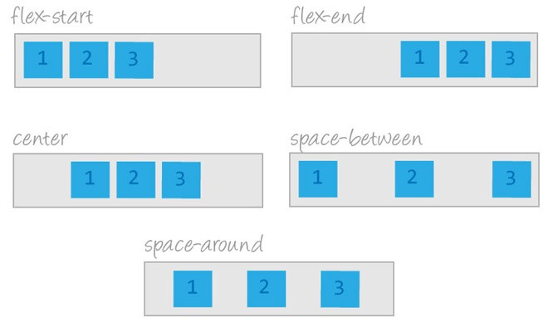
Features
Platforms- React-Native supports iOS and Android
Flexbox - Accommodate varying screen sizes by providing flexbox support
Native - can eject application out of React Native and continue Development natively
Can go from React Native app To Native app
Can publish to app store directly From React Native

Slide 5
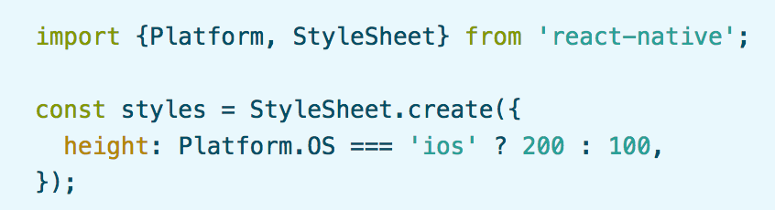
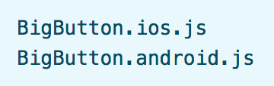
Platform Specific Code
React Native provides a way to organize your code and separate it by platform
Useful for cross-platform applications
Two ways to organize code by platform
Using the Platform module - when small parts are platform specific
Using platform specific file extensions - when platform specific code is complex

Slide 6
Integrate React-Native with Existing Applications
React Native can be used to add functionality to existing native applications
How to integrate React Native components into iOS application
Set up React Native dependencies & directory structure
Learn what React Native components you will be using
Add components & dependencies using CocoaPods
Develop your new React Native components
Add a RCTRootView to your iOS app (container for React Native component).
Start React Native server and run native application
Check that React Native portion of your application works properly

Slide 7
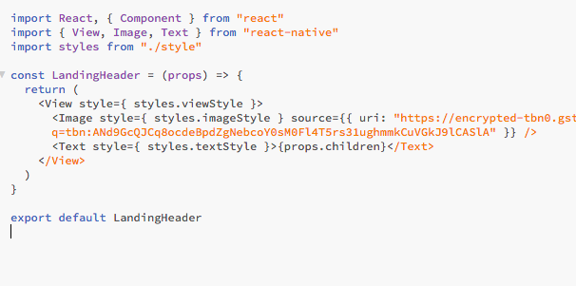
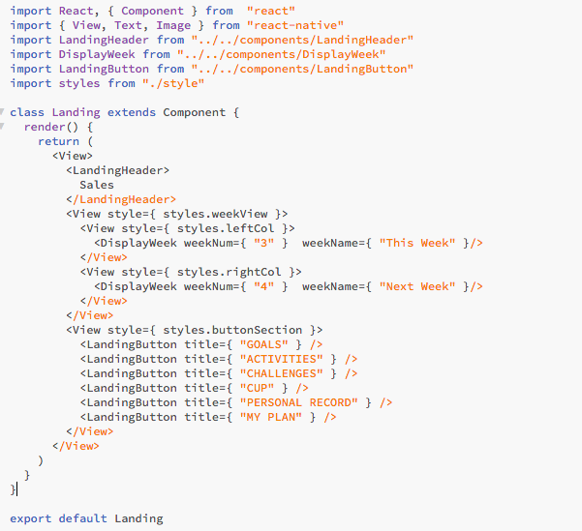
Props
A prop is immutable
A prop lets you create a single component that is used in many different places in the application.

Slide 8
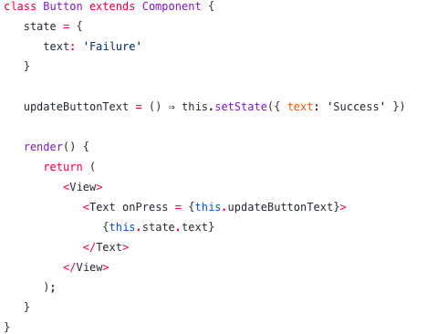
States
A State is mutable
State is nothing but a triggering method which is used to refresh or update values in the Component. Each time when ‘setState’ is called, the render() function in a Component will be called simultaneously.

Slide 9






Reactive Native Applications

Slide 10
References
Android, T. (2017, November 04). Props and State in React Native – TakeOff Android – Medium. Retrieved May 9, 2018, from https://medium.com/@takeoffandroid/props-and-state-in-react-native-c61589bf4cda
Buna, S. (2017, March 30). Yes, React is taking over front-end development. The question is why. Retrieved May 9, 2018, from https://medium.freecodecamp.org/yes-react-is-taking-over-front-end-development-the-question-is-why-40837af8ab76
Kunsmanas, M. (2017, April 12). React: A Front-End Developer's Perspective. Retrieved May 9, 2018, from https://www.devbridge.com/articles/react-a-front-end-developers-perspective/#
React Native · A framework for building native apps using React. (n.d.). Retrieved May 9, 2018, from https://facebook.github.io/react-native/

